Slide 1
Surface Water Improvement and Management (SWIM) Plan Update
Pensacola Bay System
January 11, 2017

Slide 2
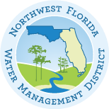
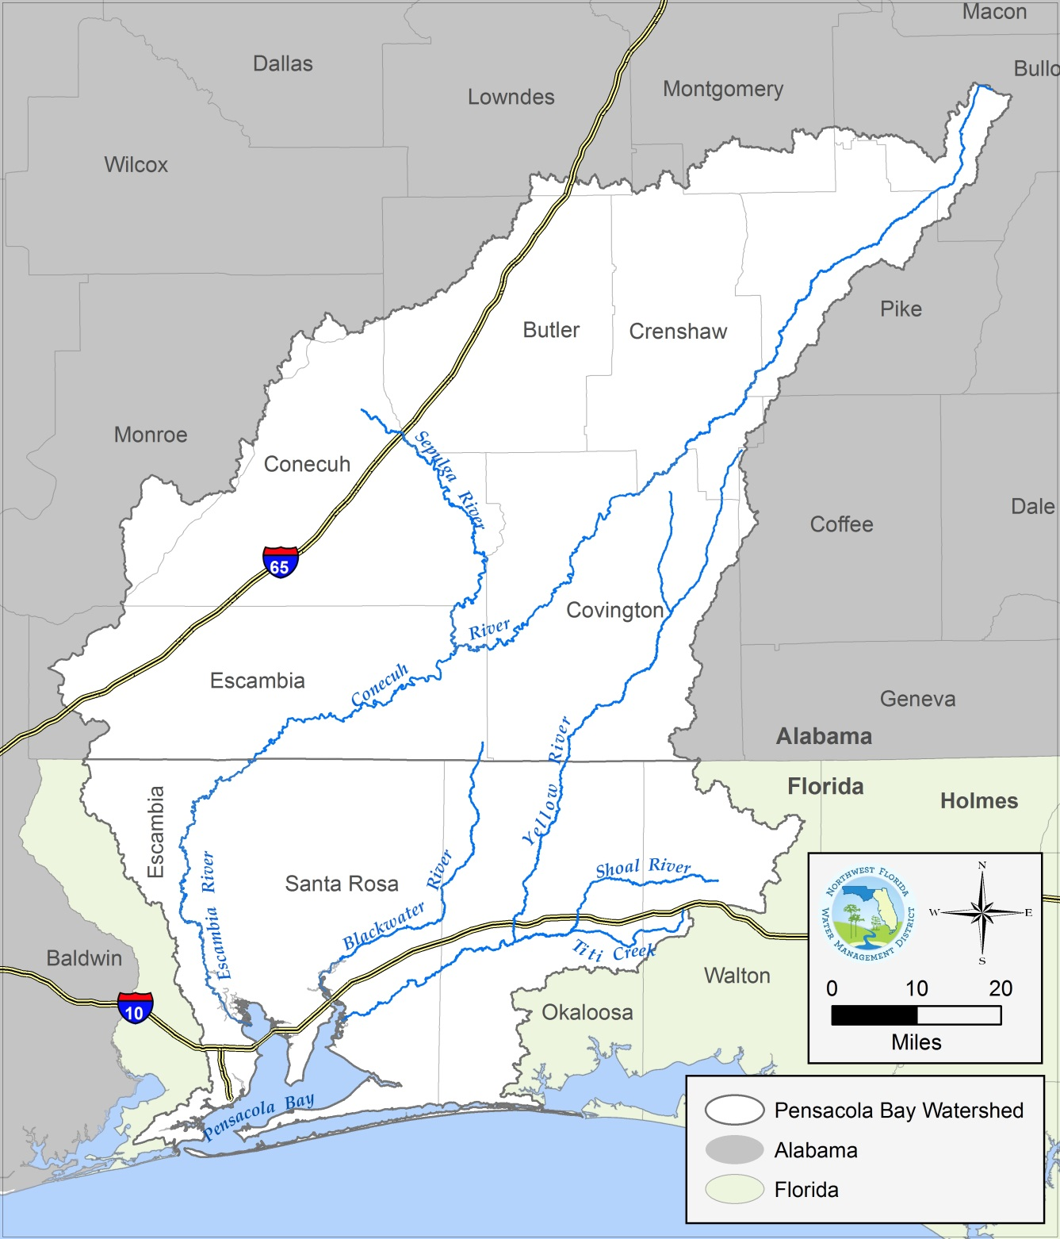
NORTHWEST FLORIDA WATER MANAGEMENT DISTRICT
Pensacola Bay System
65% in Alabama; 35% in Florida
Four of Florida’s major rivers
Five interconnected estuaries with a combined surface area of approximately 186 square miles
2010 watershed population estimated at over 420,000 in Florida alone

Slide 3
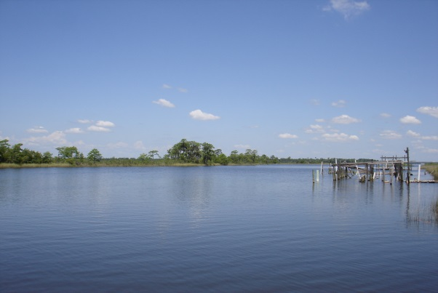
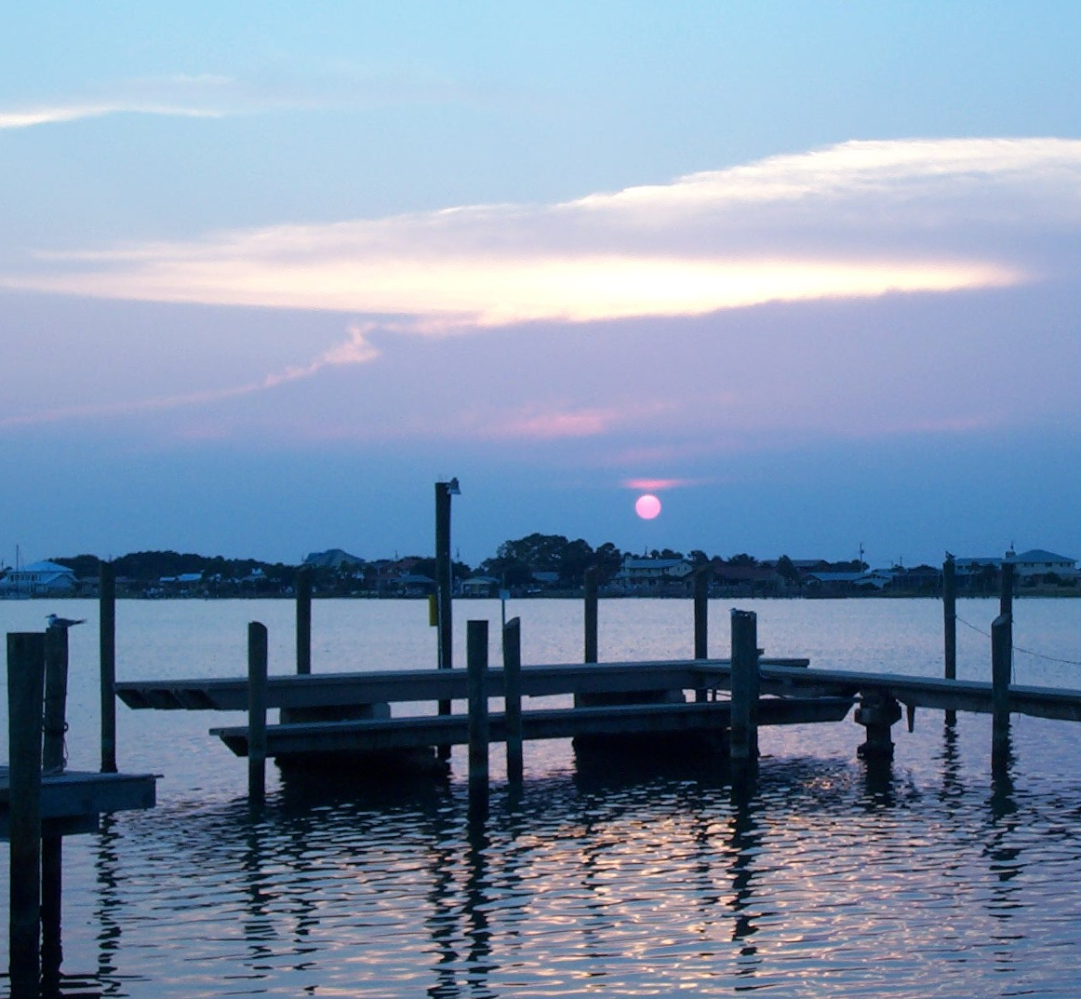
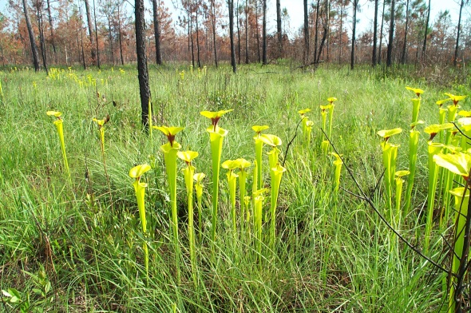
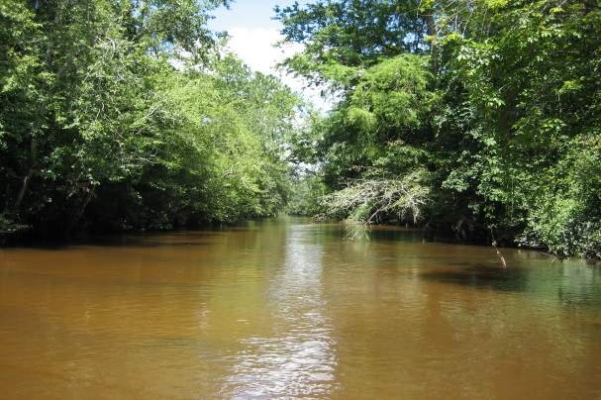
NORTHWEST FLORIDA WATER MANAGEMENT DISTRICT
Pensacola Bay System

Slide 4
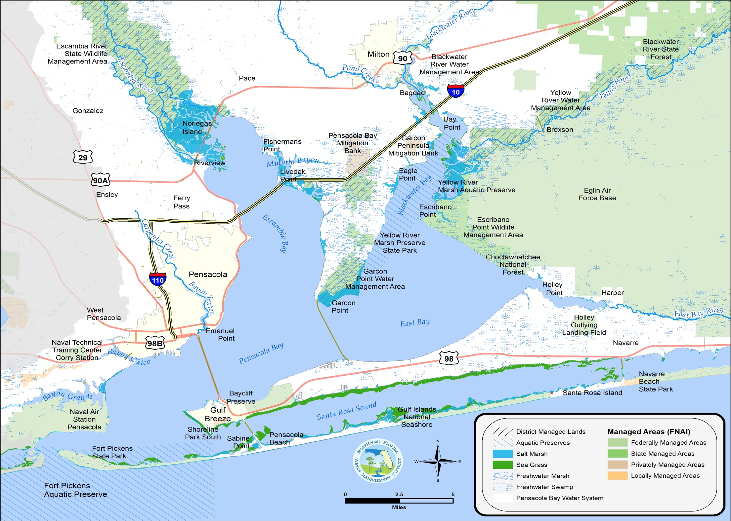
NORTHWEST FLORIDA WATER MANAGEMENT DISTRICT

Slide 5
NORTHWEST FLORIDA WATER MANAGEMENT DISTRICT
Pensacola Bay System
The Escambia, Blackwater, Yellow, and Shoal rivers have a combined annual average discharge into the bay of approximately 8,700 cubic feet per second (5,663 million gallons per day)
Roughly 3,900 acres of seagrass (2010), over 70% within Santa Rosa Sound
Over 500,000 acres of public conservation lands within the watershed, including Gulf Island National Seashore; Escambia River, Yellow River, Blackwater River, and Garcon Point water management areas; Blackwater River State Forest; Fort Pickens State Park; and Escambia County’s Jones Swamp Preserve and Greenway. Significant Department of Defense lands and two private mitigation banks are also managed to protect and restore natural resources.
Important coastal barrier, including Santa Rosa Island and Gulf Islands National Seashore

Slide 6
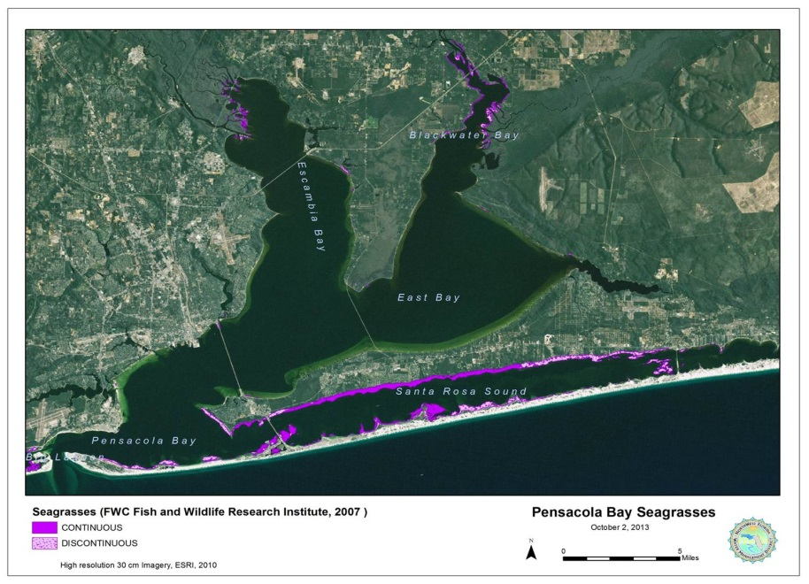
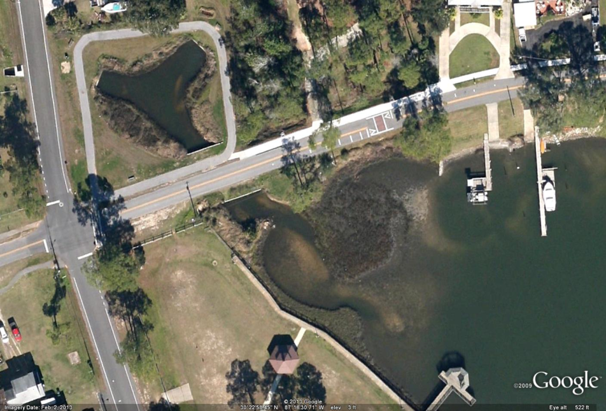
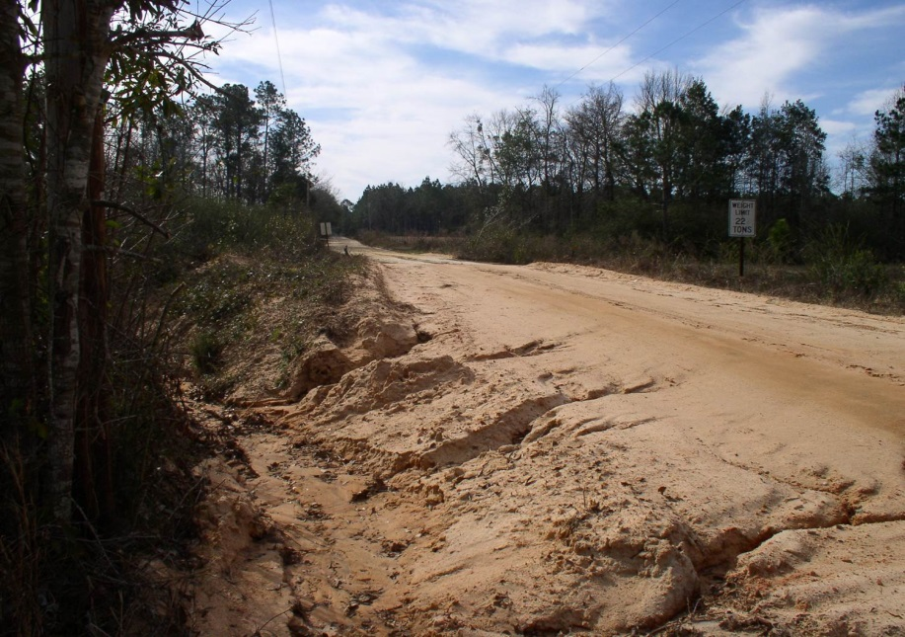
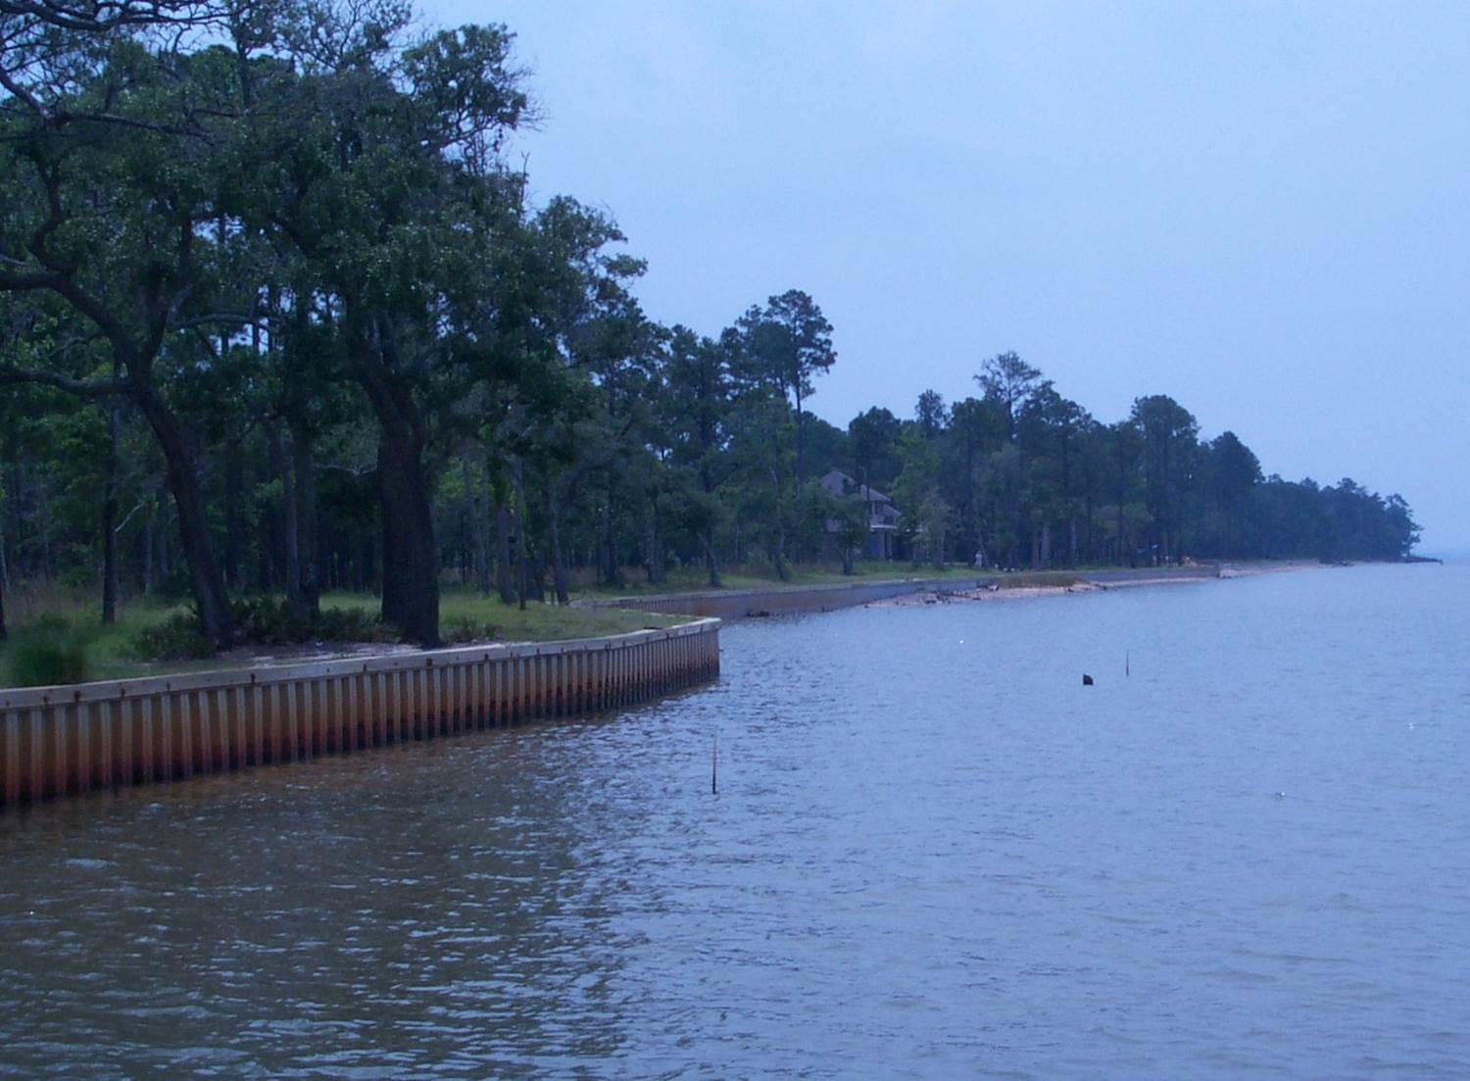
NORTHWEST FLORIDA WATER MANAGEMENT DISTRICT
Watershed Challenges

Slide 7
NORTHWEST FLORIDA WATER MANAGEMENT DISTRICT
Watershed Challenges
Water quality
Verified impairments for bacteria, nutrients and dissolved oxygen affecting Escambia Bay, Pensacola Bay, Santa Rosa Sound, the Yellow River basin, and bayous Chico and Grande
Over 44,000 septic systems identified within the Florida portion of the watershed in 2012 (FDOH permit data)
Estimated loss of seagrasses since 1960 ~ 5,000 acres, including most of the submerged vegetation in Pensacola, Escambia, and East bays

Slide 8
NORTHWEST FLORIDA WATER MANAGEMENT DISTRICT
Watershed Challenges
Established Total Maximum Daily Loads
Fecal Coliform | Nutrients | Dissolved Oxygen
Bayou Chico | North Escambia Bay | Judges Bayou
Jones Creek | Judges Bayou
Jackson Creek | Bayou Chico
Bayou Chico Beach | Bayou Chico
Sanders Beach
Escambia River
Texar Bayou
Carpenter Creek
Blackwater River (Tidal)
Yellow River
Turkey Creek
East Bay River (Marine Portion)
Plus an additional 80 watershed segments with TMDLs established for Mercury

Slide 9
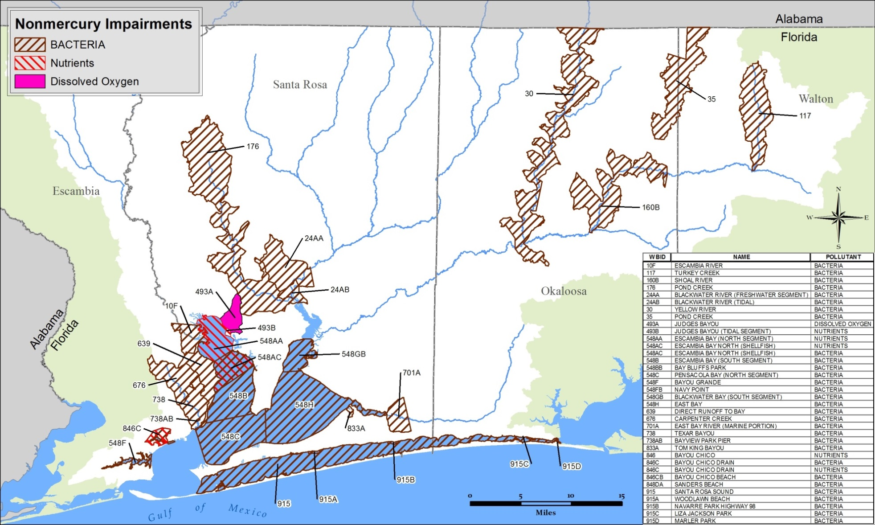
NORTHWEST FLORIDA WATER MANAGEMENT DISTRICT
Watershed Challenges
Non-Mercury Impairments

Slide 10
NORTHWEST FLORIDA WATER MANAGEMENT DISTRICT
Watershed Challenges
Water quality (continued)
Nonpoint source pollution from urban areas, agricultural land uses, and construction sites
Sedimentation from unpaved roads, streambank erosion, and other erosion sites;
Extensive areas of impervious surface, resulting in hydrologic and water quality impacts to tributary streams and receiving waters
Industrial and domestic wastewater facilities; potential to develop additional water reclamation and reuse
Over 44,000 septic systems identified within the Florida portion of the watershed in 2012 (FDOH permit data)
Five National Priority List Superfund sites within the watershed

Slide 11
NORTHWEST FLORIDA WATER MANAGEMENT DISTRICT
Watershed Challenges
Habitat quality
Estimated loss of seagrasses since 1960 ~ 5,000 acres, including most of the submerged vegetation in Pensacola, Escambia, and East bays
Exposure to oil impacts from 2010 Deepwater Horizon oil spill, proximate to the pass and Santa Rosa Sound
Documented sediment contamination, particularly within bayous Chico, Texar, and Grande; Escambia Bay, and Pensacola Bay; additional changes to sediment (siltation, reduced grain size) affect benthic habitat quality in East Bay and elsewhere
Notes:
Are there emerging or potentially emerging invasive aquatic or wetland species that deserve further attention?
(for EP or comparable longer term follow-up)

Slide 12
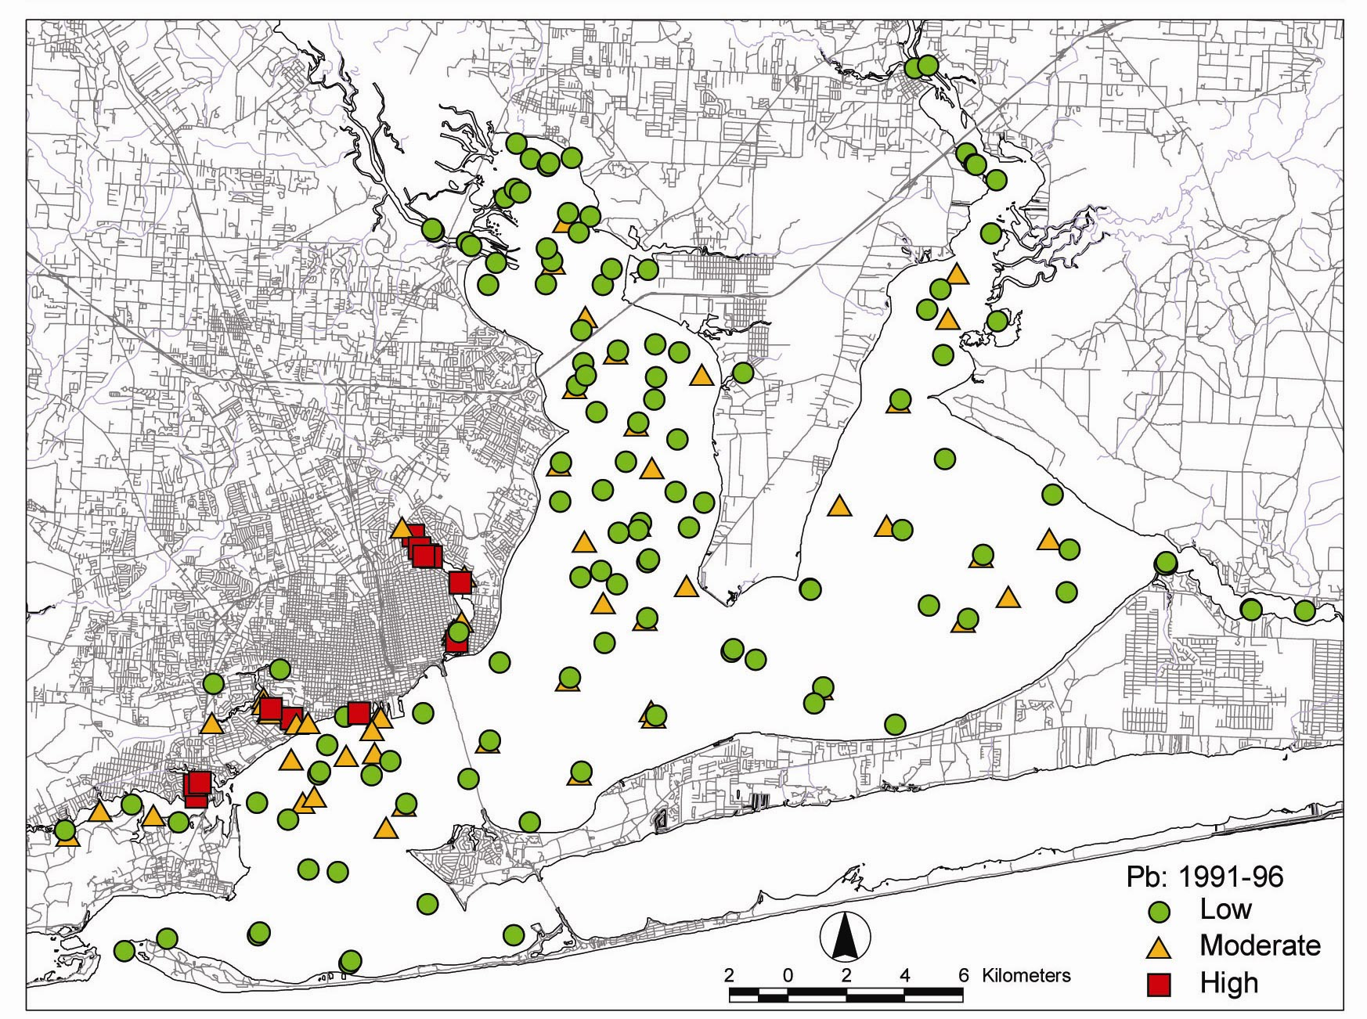
NORTHWEST FLORIDA WATER MANAGEMENT DISTRICT
Watershed Challenges
Notes:
May have implications for seagrass/benthic restoration, as well as being indicative of NPS and point source pollution
(for EP or comparable longer term follow-up)

Slide 13
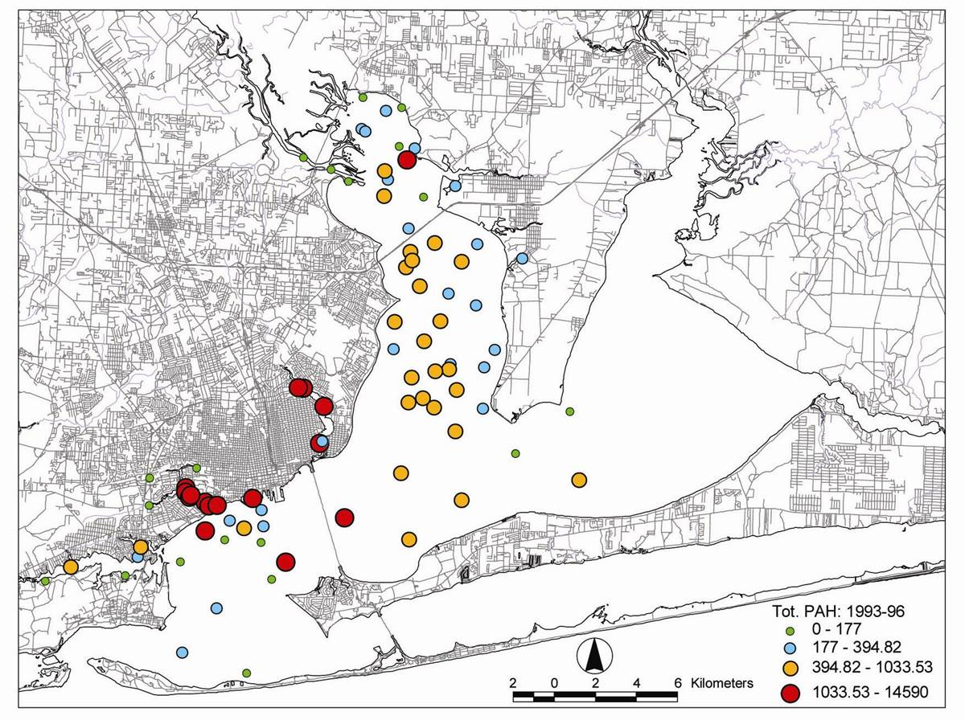
NORTHWEST FLORIDA WATER MANAGEMENT DISTRICT
Watershed Challenges

Slide 14
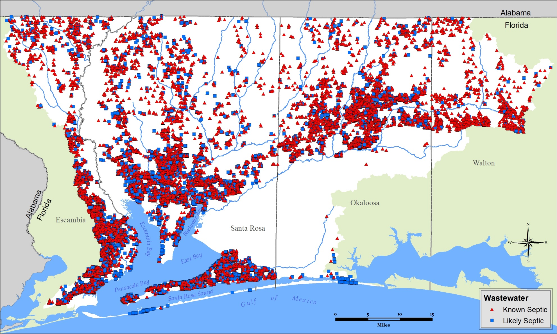
NORTHWEST FLORIDA WATER MANAGEMENT DISTRICT
Watershed Challenges

Slide 15
NORTHWEST FLORIDA WATER MANAGEMENT DISTRICT
Roadblocks to Seagrass Recovery
Project Update – Florida Fish and Wildlife Research Institute

Slide 16
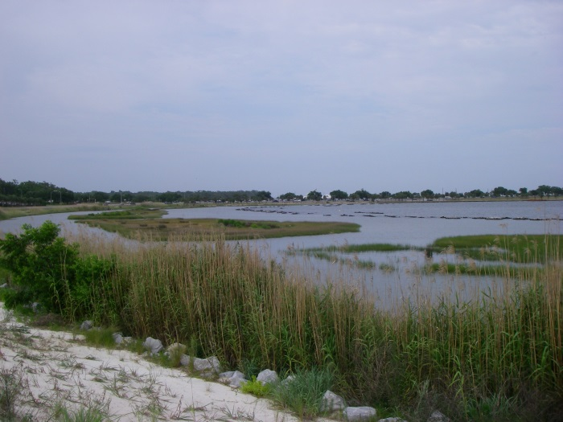
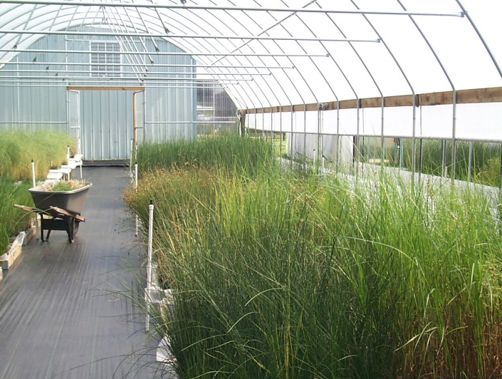
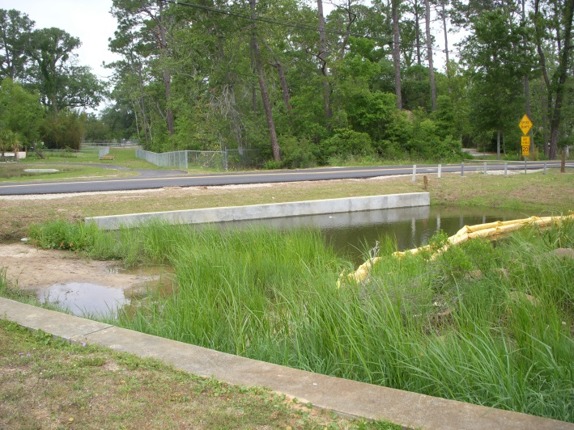
NORTHWEST FLORIDA WATER MANAGEMENT DISTRICT
Implementation

Slide 17
NORTHWEST FLORIDA WATER MANAGEMENT DISTRICT
An Array of Funding Resources
RESTORE Bucket 1 County MYIPs | NFWF Gulf Environmental Benefit Fund | Florida Legislature
RESTORE Bucket 2 Gulf Coast Ecosystem Restoration Council | Florida Springs Restoration Funding | US EPA Section 319 Grants
RESTORE Bucket 3 Florida Gulf Consortium | NRDA Natural Resource Damage Assessment | Triumph Gulf Coast Inc.
RESTORE Bucket 4 NOAA Science Program | Florida Land Acquisition Trust Fund | TMDL Water Quality Restoration Grants
RESTORE Bucket 5 FL Inst. of Oceanography | Clean Water State Revolving Fund | FL Coastal Mgt Program
Notes:
Many related programs – all with different guidelines concerning what is eligible for funding
The main point here is that the focus and legislative intent for SWIM is limited to plans and programs for the improvement and management of surface waters.
Therefore not everything that is eligible for funding through some of these programs will be included within SWIM plans.
Some have goals for economic development, tourism, Gulf of Mexico fisheries, and working waterfronts that are not necessarily appropriate for SWIM.
Therefore what is or is not included within SWIM plans do not necessarily affect eligibility for other funding sources.

Slide 18
NORTHWEST FLORIDA WATER MANAGEMENT DISTRICT
Watershed Specific Objectives
Conceptual Objectives and Priorities (January 2017)
Continued investments in urban stormwater retrofit
Septic to sewer connections
Evaluate innovative passive onsite wastewater treatment technologies
Prioritize and address unpaved road stream crossings
Prioritize and restore other sedimentation sources and erosion sites
Notes:
Conceptual Objectives and Priorities (January 2017)
Working with local governments, evaluate NPS treatment improvement priorities for water quality improvement, as well as flood protection (preferably multipurpose projects)
Work with ECUA to identify areas to take OSTDSs offline through extension of central sewer service
Evaluate the potential of passive innovative technology onsite systems where central sewer connection is not cost-effective
Prioritize and address unpaved road stream crossings
Prioritize and restore other sedimentation sources and erosion sites – including gulley erosion affecting streams within the Blackwater and Yellow river basins and eroding borrow pits
Clear Creek
Big Escambia Creek
Julian Mill Creek
more

Slide 19
NORTHWEST FLORIDA WATER MANAGEMENT DISTRICT
Watershed Specific Objectives
Conceptual Objectives (continued)
Restoration of seagrass habitats
Protect and restore major wetland drainages – including Jones Swamp, Garcon Point, and the Yellow River basin
Implement enhanced agricultural best management practices, building upon efforts ongoing in other parts of the state
Investments in wastewater system improvements – addressing inflow and infiltration and water reclamation and reuse
Long-term, sustainable forestry practices
Notes:
Again note that wastewater is outside the implementation AOR of SWIM – but important to recognize
Restoration of seagrass habitats
Protect and restore major wetland drainages – including Jones Swamp, Garcon Point, and the Yellow River basin
Implementation of enhanced agricultural best management practices, building upon efforts ongoing in other parts of the state
Continued investments in wastewater system improvements – addressing inflow and infiltration and water reclamation and reuse
Long-term, sustainable forestry practices – build upon significant public and private efforts to date to facilitate habitat restoration and protection of water quality and hydrologic functions and benefits of forested watersheds

Slide 20
NORTHWEST FLORIDA WATER MANAGEMENT DISTRICT
Watershed Specific Objectives
Conceptual Objectives (continued)
Cooperative estuarine habitat restoration initiatives
Continued progress in urban bayou restoration:
Bayou Chico BMAP
Community-based restoration efforts
Urban stormwater retrofit
Headwater stream and wetland restoration
Notes:
Conceptual Objectives (continued)
Cooperative estuarine habitat restoration initiatives – examples: Project Greenshores, East Bay oyster habitat restoration, living shorelines for restoration of impacted/altered shoreline areas
Continued progress in urban bayou restoration:
Bayou Chico BMAP – Clean Marinas, stormwater treatment, central sewer connections, headwaters restoration, inflow and infiltration reduction
Community-based restoration efforts
Urban stormwater retrofit
Headwater stream restoration, including channel and floodplain function restoration

Slide 21
NORTHWEST FLORIDA WATER MANAGEMENT DISTRICT
Projects and Management Practices
Project/Practice | Objectives | Lead Entities
Urban Stormwater Retrofits | Water quality improvement Flood protection Potential specific project examples: Hollice T. Williams Park Multipurpose Retrofit Santa Rosa Sound Water Quality Improvement Navy Point Rain Gardens/Bioretention Lake Charlene/Bridle Trail Stormwater Forest Creek Apartment Complex Woodlands – UWF Scenic Hills Bayou Chico BMAP Stormwater Improvements | Local governments
Monitoring Program Development and Enhancement | Develop targeted monitoring program Identify trends Support adaptive management Building on efforts of Bream Fishermen’s Association, FDOH, FDEP, and others | Estuary Program Regional watershed initiatives
Notes:
Santa Rosa Sound monitoring and assessment proposed by Santa Rosa County
Note – An Estuary Program, if funded, could help coordinate and implement any of these; just called out a few where long-term coordination need is apparent

Slide 22
NORTHWEST FLORIDA WATER MANAGEMENT DISTRICT
Projects and Management Practices
Project/Practice | Objectives | Lead Entities
Agricultural Best Management Practices (BMPs) | Water quality protection Water use efficiency Building upon initiatives developing in other regions of the state. Includes Pensacola and Perdido Rivers & Bays Agricultural Water Quality and Conservation Cost Share Initiative – Florida Department of Agricultural and Consumer Services | FDACS NRCS Private producers NWFWMD
Silviculture BMPs | Water quality protection Habitat protection Building on Florida's Silviculture BMP program (FDACS); cooperative effort between public agencies and private landowners | FDACS Private landowners Public landowners
Basinwide Sedimentation Abatement | Watershed assessment of impacts from unpaved roads and other erosion sites Prioritize sites Support implementation Unpaved road/stream crossing sites Shoal River Headwaters Julian Mill Creek Restoration Borrow pits | Local governments Estuary Program
Notes:
Sedimentation assessments and prioritizations completed and funded in the Choctawhatchee watershed.

Slide 23
NORTHWEST FLORIDA WATER MANAGEMENT DISTRICT
Projects and Management Practices
Project/Practice | Objectives | Lead Entities
Hydrologic Restoration | Restoration of natural wetland, floodplain, and estuarine hydrology Stream channel restoration Enhance resiliency through biodiversity and natural adaptation enhancement Jones Swamp Basin Jackson Branch Headwaters Carpenter Creek/Bayou Texar Restoration | State and federal resource agencies Local governments Estuary Program
Wetland Restoration | Restore wetland functions: fish and wildlife habitat, floodwater storage, discharge regulation, water quality protection, aquifer recharge, and more Enhance resiliency through biodiversity and natural adaptation enhancement Jones Swamp Basin Woodlands – UWF Scenic Hills Navy Point Littoral wetlands and ecotonal areas | Local governments Estuary Program State and federal resource agencies

Slide 24
NORTHWEST FLORIDA WATER MANAGEMENT DISTRICT
Projects and Management Practices
Project/Practice | Objectives | Lead Entities
Subbasin Plans | Comprehensive restoration plans for targeted basins (e.g., urban bayous) Carpenter Creek Jones Swamp Jones Swamp/Bayou Chico More | Local governments Estuary Program
Seagrass Restoration | Targeted restoration in areas where water quality and other supporting site conditions have been achieved | Estuary Program Florida FWRI Local governments
In-Estuarine Restoration | Benthic habitat restoration Oyster reef establishment Evaluation of alternative systems: aeration systems, pumped flushing systems, oyster habitat for water quality improvement Bayou Chico sediment removal East Bay Oyster Habitat Restoration Project | Estuary Program TNC Escambia County City of Pensacola Florida FWRI Bayou Chico Association
Notes:
Floating Islands
Aeration systems proposed by Bayou Chico Association for BMAP

Slide 25
NORTHWEST FLORIDA WATER MANAGEMENT DISTRICT
Projects and Management Practices
Project/Practice | Objectives | Lead Entities
Water Reclama-tion and Reuse | Protect water quality through improved treatment and reduced discharges Water conservation/demand management Conserve potable water sources Includes initiatives for Santa Rosa Sound and the Blackwater River basin, among others | Utilities Local governments
OSTDS to Central Sewer Connections | Connect areas served by OSTDS to central sewer systems WWTF/WRF Improvements Includes initiatives for Santa Rosa Sound and the Blackwater River basin, among others Santa Rosa Sound Water Quality Improvement Program Shoal River Headwaters Bayou Grande Basin Bayou Chico BMAP Area More | Utilities Local governments FDOH FDEP
Advanced Technology OSTDS | Implement affordable, new technology passive OSTDS in areas where connection to central sewer is not cost-effective Build upon and adapt efforts underway in other regions | Utilities Local governments

Slide 26
NORTHWEST FLORIDA WATER MANAGEMENT DISTRICT
Projects and Management Practices
Project/Practice | Objectives | Lead Entities
Riparian Buffer Zones | Water quality protection Shoreline Stability Habitat Enhance resiliency through biodiversity and natural adaptation enhancement | Private landowners Local governments Estuary Program
Living Shorelines | Shoreline habitat restoration Implementation of alternative method of shoreline protection that enriches littoral and aquatic habitat and productivity Enhance resiliency through biodiversity and natural adaptation enhancement NAS, White Island, and Escambia County Living Shoreline | Estuary Program State and federal resource agencies Local governments
Interstate Coordination | Coordination of priority watershed management efforts across state lines | Estuary program

Slide 27
NORTHWEST FLORIDA WATER MANAGEMENT DISTRICT
Projects and Management Practices
Project/Practice | Objectives | Lead Entities
Landscape Scale Headwaters and Longleaf Pine Ecosystem Protection and Restoration | Achieve perpetual working forest conservation easements Restore historic longleaf pine ecosystem on approximately 205,000 acres (100,000 in Florida) Coastal Headwaters Longleaf Forest Related GCPEP proposal through TNC Community Watershed Plan | The Conservation Fund Gulf Coastal Plain Ecosystem Partnership FDACS Private landowners
Evaluation and Planning for Strategic Land Acquisition and Conservation | Water resource protection for water quality, floodplain, and aquatic and wetland habitat protection Multiple specific projects proposed through Community-based Watershed Plans | Local governments Private non-profit initiatives Estuary Program FDEP
Notes:
Marina BMPs as part of Bayou Chico BMAP

Slide 28
NORTHWEST FLORIDA WATER MANAGEMENT DISTRICT
Projects and Management Practices
Project/Practice | Objectives | Lead Entities
Watershed Stewardship Initiatives | Build citizen engagement opportunity and capacity, including: Citizen science Monitoring Training and outreach Habitat enhancement; oyster gardening Cost-share assistance to landowners to convert hardened to living shorelines Urban and Marina BMPs Offer Your Shell to Enhance Restoration (OYSTER) | Estuary Program IFAS Extension/Sea Grant Local Governments Proposed through Community-Based Watershed Plans
Notes:
Marina BMPs as part of Bayou Chico BMAP

Slide 29
NORTHWEST FLORIDA WATER MANAGEMENT DISTRICT
Criteria for Project Planning and Evaluation
Infrastructure projects (stormwater and wastewater)
Projects should have responsible parties that will implement, own, operate, and maintain the facilities
Responsible parties should have dedicated funding source for operation and maintenance
Restoration and habitat enhancement
Completed project should be naturally self-sustaining; not requiring frequent human intervention
Restoration should reflect ecosystems or habitats that are naturally supported in the watershed and physical environment
Completed restoration sites should be adaptable to natural change and variability – short-term and long-term

Slide 30
NORTHWEST FLORIDA WATER MANAGEMENT DISTRICT
SWIM Plan Updates – Schedule
2015 |  |  |  |  | 2016 |  |  |  |  |  |  |  |  |  |  |  | 2017
AUG | SEP | OCT | NOV | DEC | JAN | FEB | MAR | APR | MAY | JUN | JUL | AUG | SEP | OCT | NOV | DEC | JAN | FEB | MAR | APR | MAY | JUN | JUL | AUG | SEP | OCT | NOV | DEC
Designated Grant Period
Watershed Characterizations
Project Planning
Draft Plans
Final Plans
Tech. Mtgs
Public Stakeholder Review

Slide 31
NORTHWEST FLORIDA WATER MANAGEMENT DISTRICT
Thank you!
Pensacola Bay System Watershed Resource Characterization:
http://www.nwfwater.com/Water-Resources/SWIM/SWIM-Plan-Updates
Please provide comments, recommendations, and questions to: SWIM@nwfwater.com
Comments requested by March 10, 2017
For more information:
Paul Thorpe
Chief, Bureau of Environmental and Resource Planning
Northwest Florida Water Management District
(850) 539-5999
Paul.Thorpe@nwfwater.com
Notes:
This is where we are at now.
Management options and projects need to be:
Applicable over the long-term (thus, not only including discrete projects that have come in the door to date)
Useful for local governments and others going forward
Umbrella projects identify broad priorities – site specific project options may be identified in the years ahead and may be applicable to multiple funding sources (Florida Forever, RESTORE, etc.).
Criteria to guide evaluation and prioritization examples:
Go through examples

