Slide 1
Surface Water Improvement and Management (SWIM) Plan Development
Perdido River and Bay Watershed
January 10, 2017
Notes:
Acknowledgements
NFWF
FWC
DEP
E&E
You

Slide 2
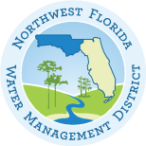

NORTHWEST FLORIDA WATER MANAGEMENT DISTRICT
Gulf Environmental
Benefit Fund (GEBF)
GEBF Restoration Strategy:
SWIM Plan Updates
(NWF & Suwannee WMDs).
Seagrass Assessment (Fish and Wildlife Research Institute).
Goal: Prioritized Project List

Slide 3
NORTHWEST FLORIDA WATER MANAGEMENT DISTRICT
Surface Water Improvement
and Management (SWIM) Program
Created through passage of the Surface Water Improvement and Management Act in 1987; Sections 451-459, Florida Statutes.
Purpose: Developed to address major watershed (coastal/ surface water) issues throughout the State.
  Plans will provide:
    Watershed description;
    Assessment of watershed and water resource conditions;
    Evaluation of accomplishments and improvements since previous SWIM Plan;
    Project plan to address identified watershed needs and challenges; and
    Estimate funding needs and funding alternatives.

Slide 4


NORTHWEST FLORIDA WATER MANAGEMENT DISTRICT
SWIM in Northwest Florida
The District developed SWIM plans for all major watersheds/ waterbodies; two (Perdido and Ochlockonee) remain in a draft status.
Waterbody | Most Recent Plan/ Update Date
Apalachicola | 1996
Pensacola | 1997
Choctawhatchee | 2002
St. Marks | 2009
St. Andrew Bay | 2000
Lake Jackson | 1997
Perdido | Draft 2011
Ochlockonee | Draft 2012

Slide 5
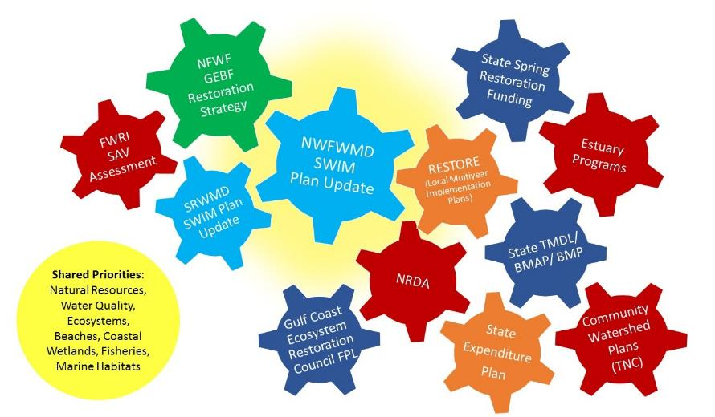
NORTHWEST FLORIDA WATER MANAGEMENT DISTRICT
Other Related Initiatives
It is important that SWIM Plan updates fit within and help guide the larger set of related Deep Water Horizon and State restoration initiatives:

Slide 6
NORTHWEST FLORIDA WATER MANAGEMENT DISTRICT
SWIM Plan Updates – Schedule
2015 |  |  |  |  | 2016 |  |  |  |  |  |  |  |  |  |  |  | 2017
AUG | SEP | OCT | NOV | DEC | JAN | FEB | MAR | APR | MAY | JUN | JUL | AUG | SEP | OCT | NOV | DEC | JAN | FEB | MAR | APR | MAY | JUN | JUL | AUG | SEP | OCT | NOV | DEC
Designated Grant Period
Watershed Characterizations
Project Planning
Draft Plans
Final Plans
Tech. Mtgs
Public Stakeholder Review

Slide 7
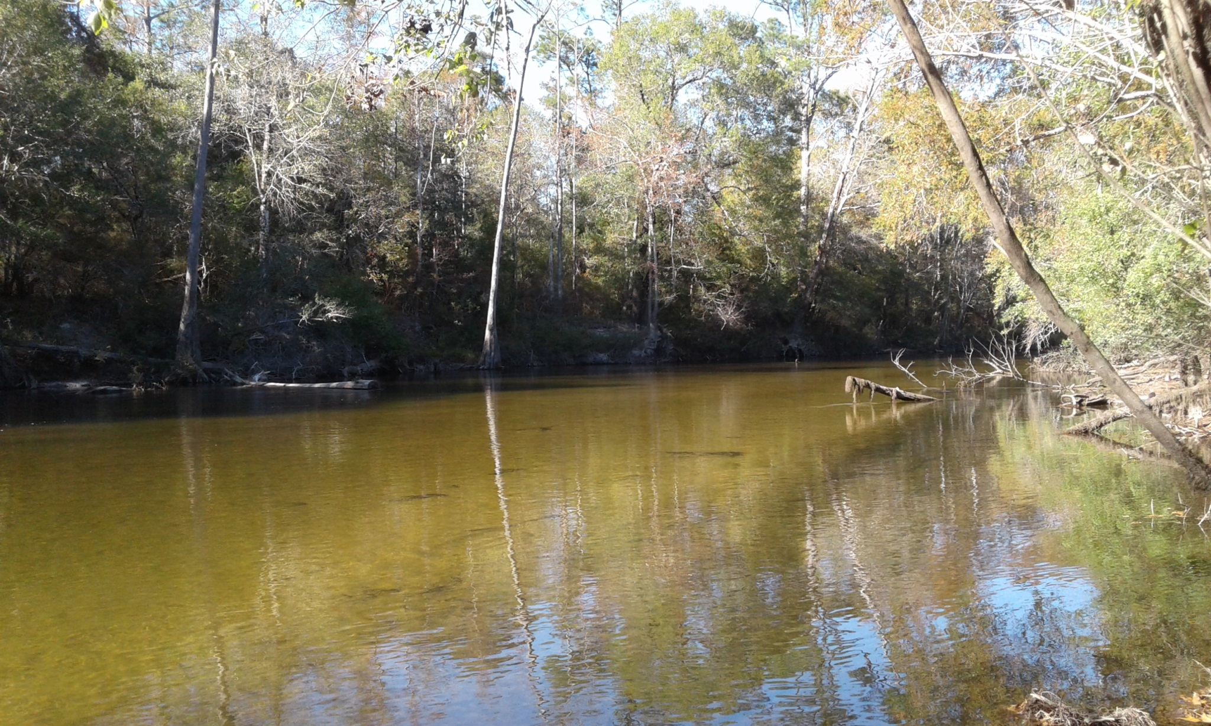
NORTHWEST FLORIDA WATER MANAGEMENT DISTRICT
Perdido River and Bay Watershed

Slide 8
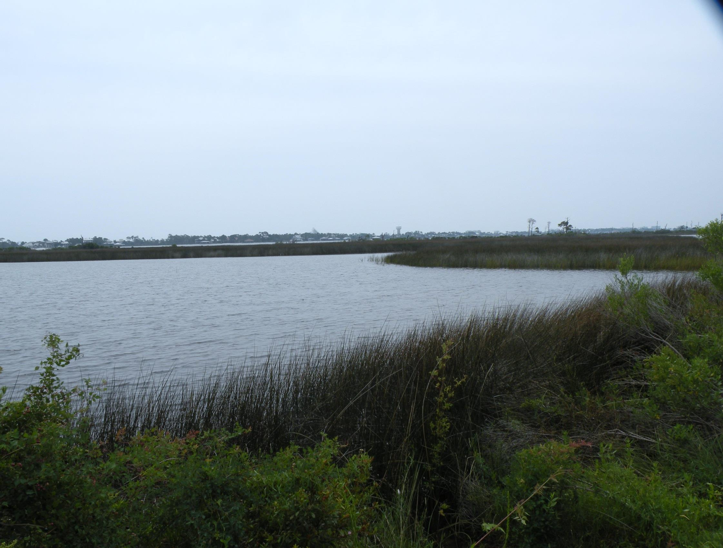

Slide 9
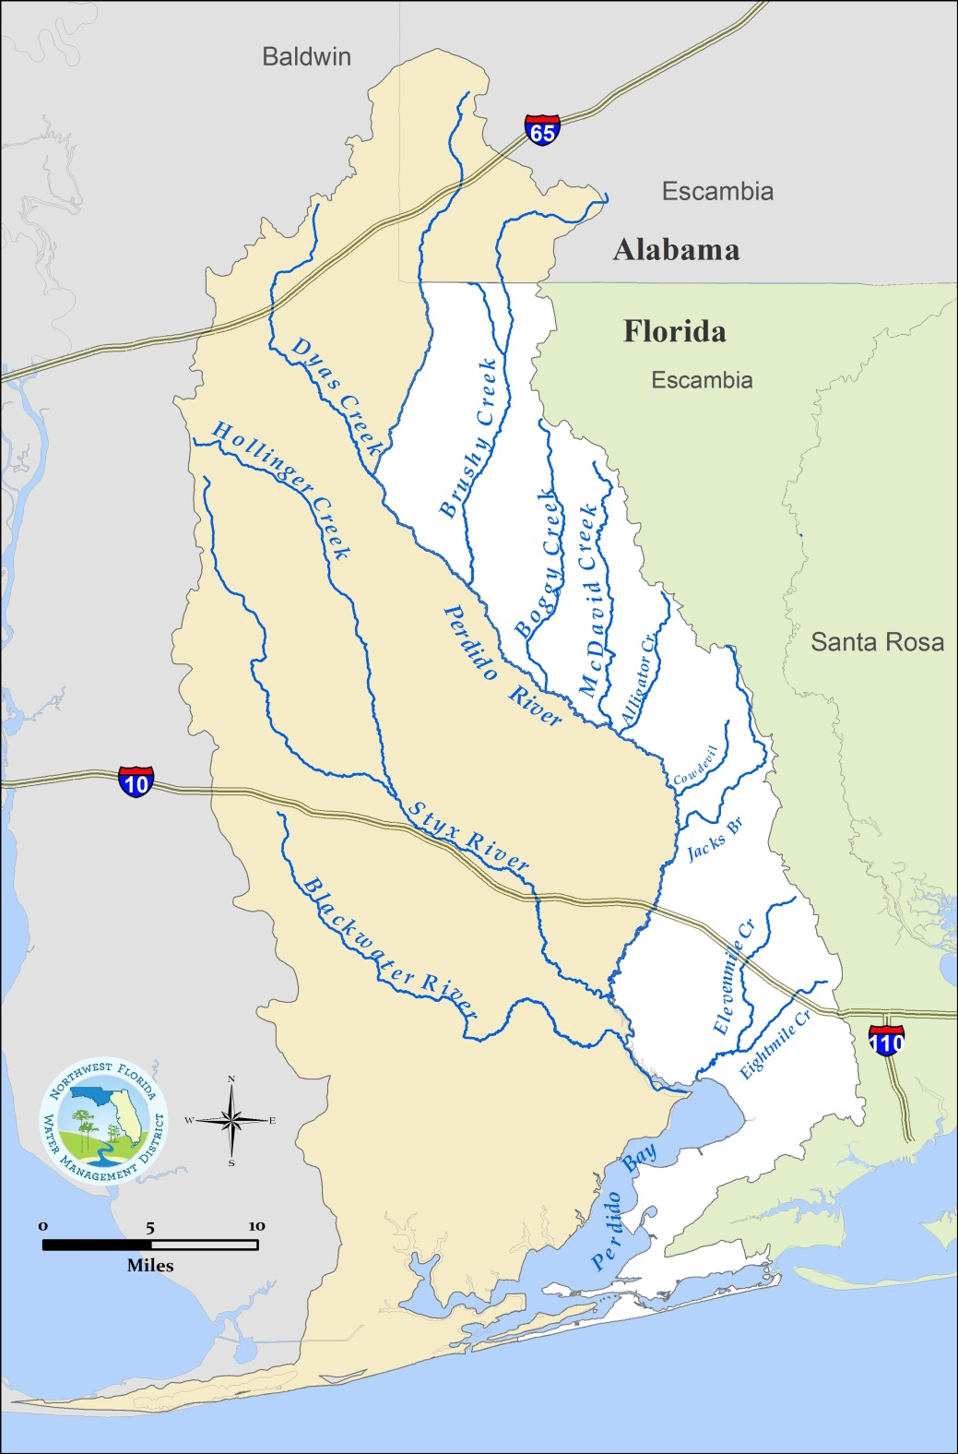
NORTHWEST FLORIDA WATER MANAGEMENT DISTRICT
Perdido River and Bay Watershed
1,165 square miles
70% in Alabama; 30% in Escambia County, Florida
Perdido River serves as the state line
Perdido River annual average discharge to Perdido Bay – 783 cubic feet per second
(506 million gallons per day)
Other major tributaries – Styx River and Blackwater River (AL), Elevenmile Creek, and Bayou Marcus

Slide 10
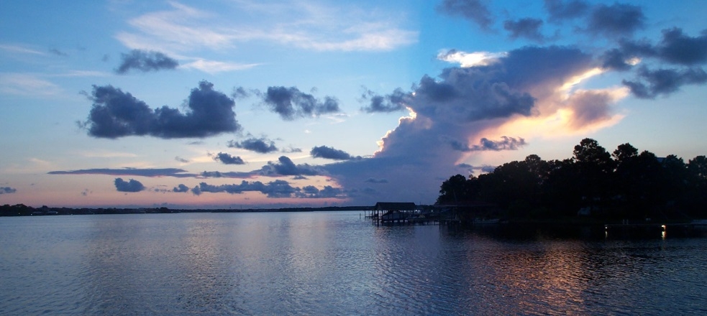
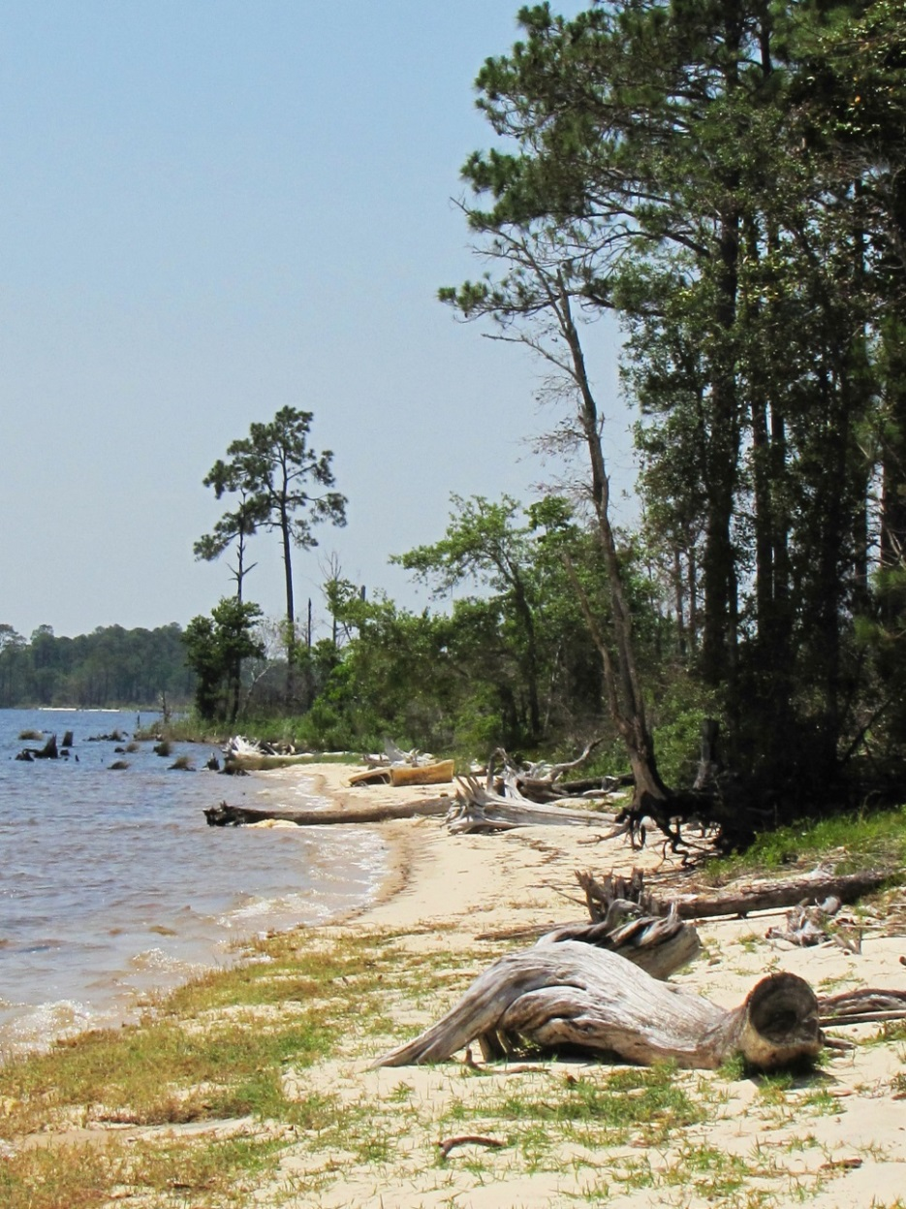
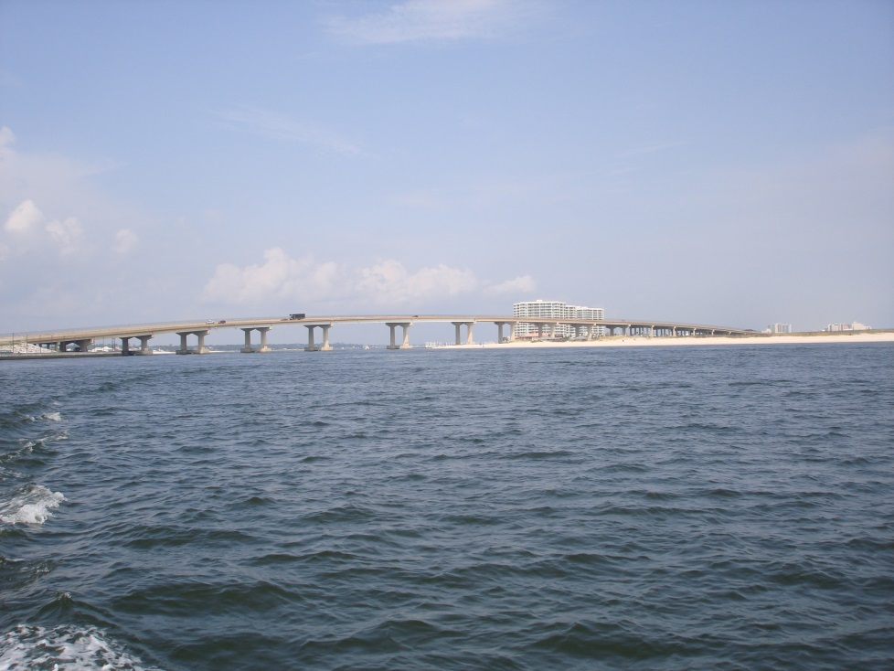
NORTHWEST FLORIDA WATER MANAGEMENT DISTRICT
Perdido River and Bay Watershed

Slide 11
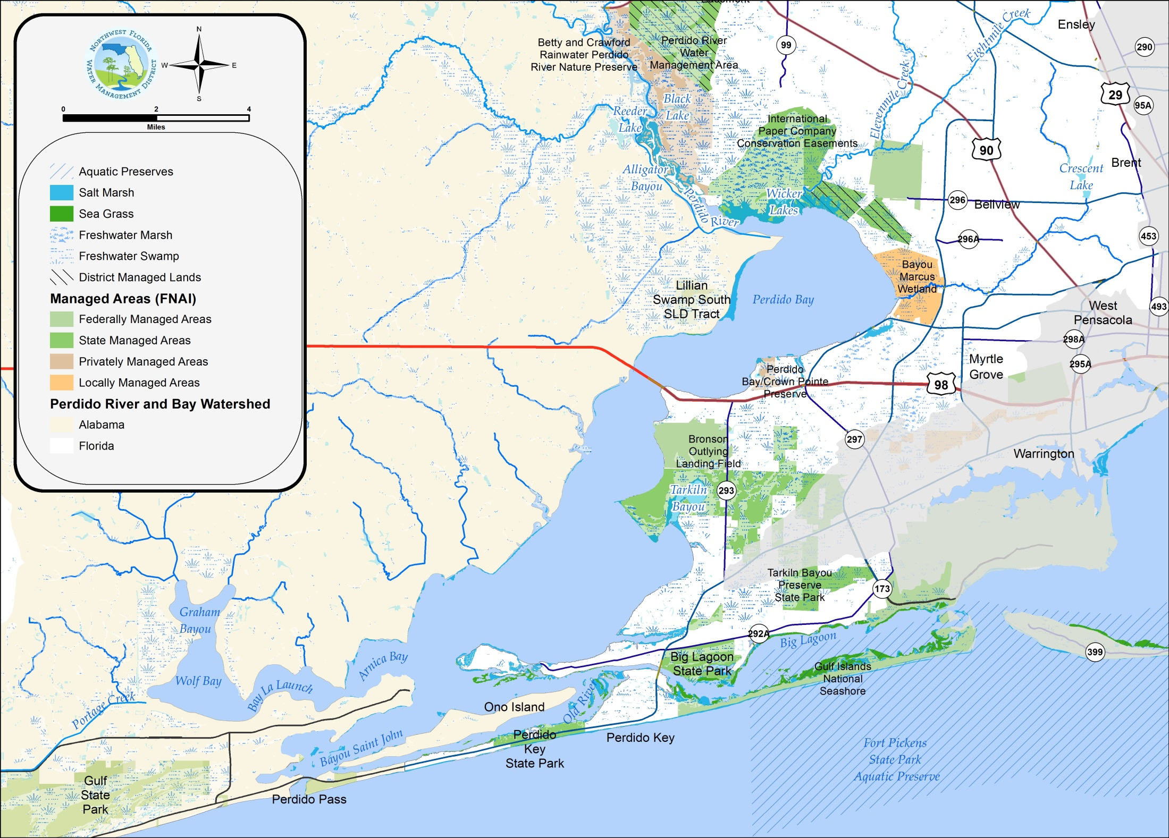
NORTHWEST FLORIDA WATER MANAGEMENT DISTRICT

Slide 12
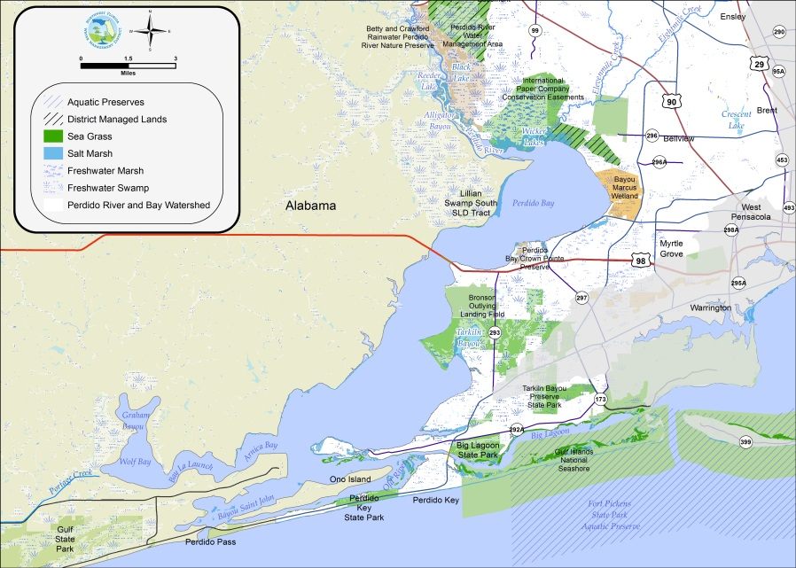
NORTHWEST FLORIDA WATER MANAGEMENT DISTRICT
Perdido River and Bay Watershed
Over 58,000 acres of freshwater and tidal wetlands
Approximately 135 acres of seagrasses within Perdido Bay (2009)
Over 20,000 acres of public conservation lands within the watershed, including Tarkiln Bayou and Big Lagoon state parks, Perdido Pitcher Plant Prairie, the NWFWMD Perdido River Water Management Area, and two Alabama state parks
Betty and Crawford Rainwater Perdido River Preserve protected by TNC
Big Lagoon – 18 square mile lagoon connecting Perdido and Pensacola bays
Important coastal barrier, including Gulf Islands National Seashore and Perdido Key State Park

Slide 13
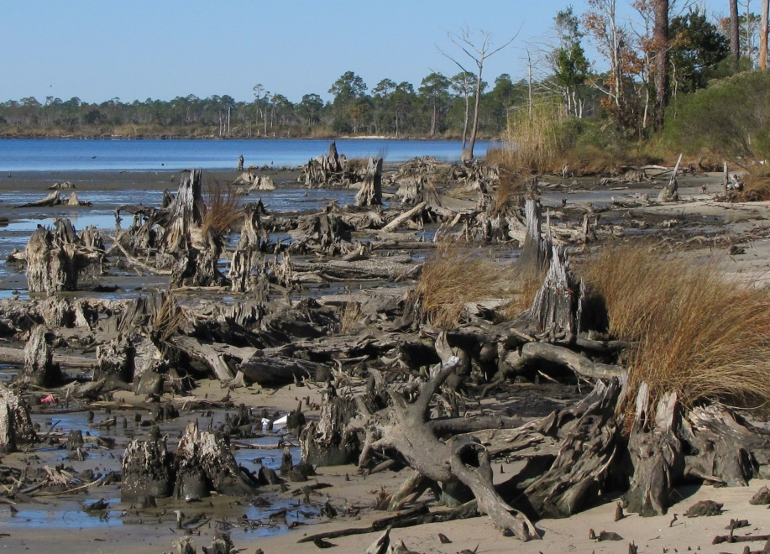
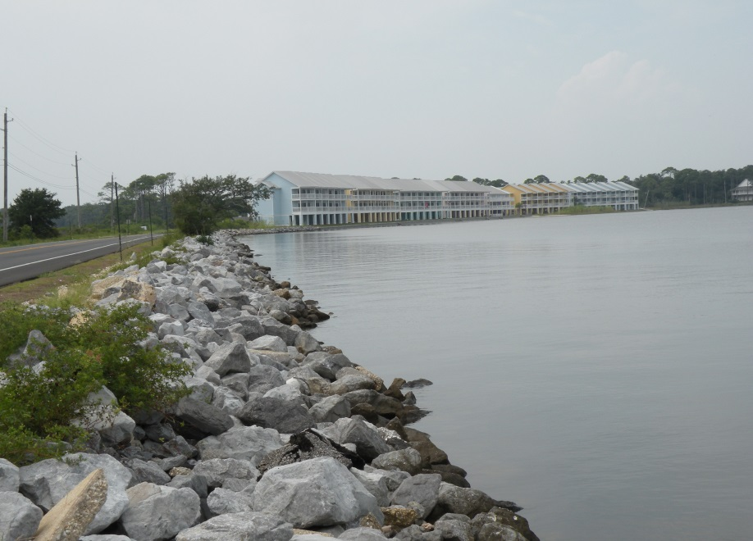
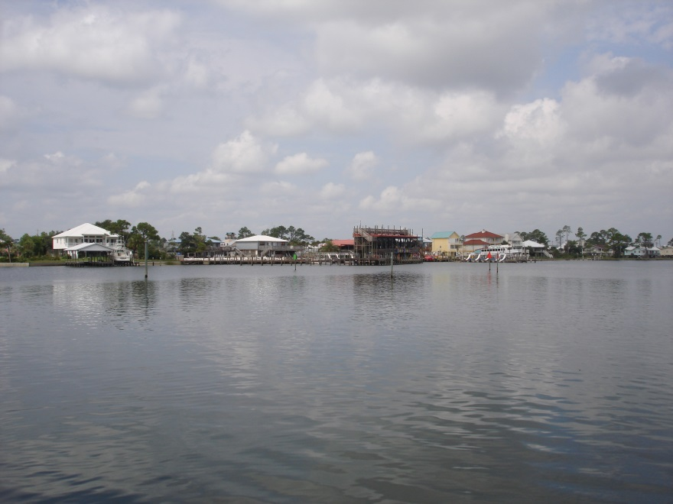
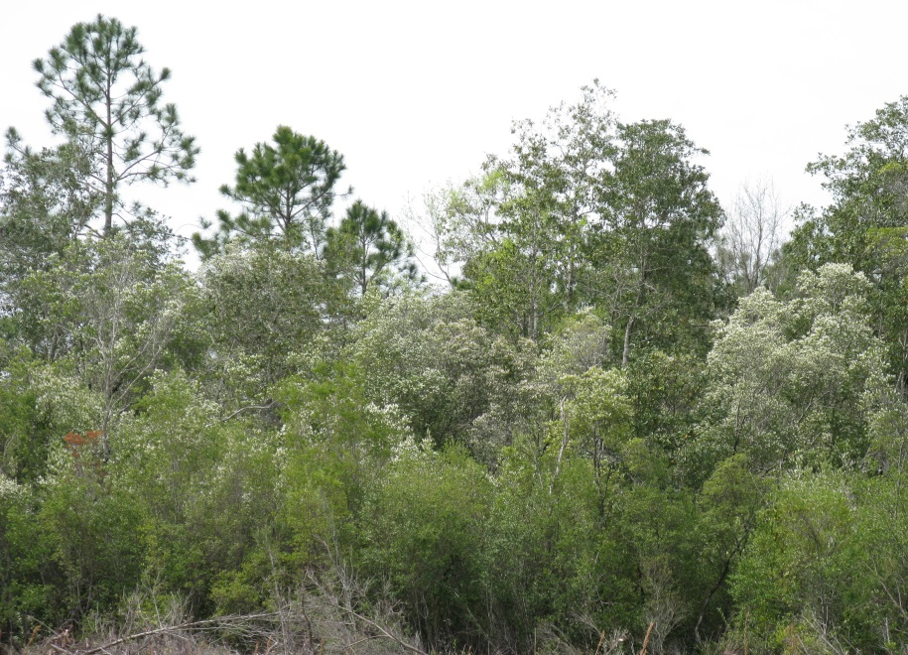
NORTHWEST FLORIDA WATER MANAGEMENT DISTRICT
Watershed Challenges

Slide 14
NORTHWEST FLORIDA WATER MANAGEMENT DISTRICT
Watershed Challenges
Water quality
  Verified impairments for dissolved oxygen and bacteria in drainages discharging into Perdido Bay and Big Lagoon
  TMDLs established for fecal coliform at Brushy Creek, Elevenmile Creek, and Tenmile Creek
  Over 12,000 septic systems identified within the Florida portion of the watershed in 2012 (FDOH permit data)
  Long-term losses of seagrasses (~80%) indicative of past and present water quality limitations, as well as physical impacts

Slide 15
NORTHWEST FLORIDA WATER MANAGEMENT DISTRICT
Watershed Challenges
Water quality (continued)
  Nonpoint source pollution from urban development and agricultural land uses
  Sedimentation from unpaved roads, streambank erosion, and other erosion sites; hydrologic and water quality impacts on streams discharging to Perdido Bay
  Industrial and domestic wastewater facilities
    International Paper – treatment wetland system
    Bayou Marcus Water Reclamation Facility – treatment wetland system

Slide 16
NORTHWEST FLORIDA WATER MANAGEMENT DISTRICT
Watershed Challenges
Habitat quality
    Long-term losses of seagrasses (~80%)
    Historic alteration of tidal wetlands
    Exposure to oil impacts from 2010 Deepwater Horizon oil spill in the vicinity of the Gulf inlet and Big Lagoon, as well as (primarily) at the Gulf beaches
    Nutrient enrichment within sediments in the upper bay and near the mouth of Elevenmile Creek
Notes:
Are there emerging or potentially emerging invasive aquatic or wetland species that deserve further attention?
(for EP or comparable longer term follow-up)

Slide 17
NORTHWEST FLORIDA WATER MANAGEMENT DISTRICT
Watershed Specific Objectives
Conceptual Objectives (January 2017)
Continued investments in urban stormwater retrofit
Septic to sewer connections
Evaluate innovative passive onsite wastewater treatment technologies
Prioritize and address unpaved road stream crossings and other sedimentation sources
Notes:
Conceptual Objectives (January 2017)
Working with Escambia County, evaluate potential NPS treatment improvements for water quality (specifically including bacteria) in tributaries of the bay and estuarine areas – including the Elevenmile Creek, Eightmile Creek, Bayou Marcus, Bridge Creek, and Bayou Garcon basins and Big Lagoon
Work with ECUA to identify areas to take OSTDSs offline through extension of central sewer service
Evaluate the potential of passive innovative technology onsite systems where central sewer connection is not cost-effective
Prioritize and address unpaved road stream crossings and other sedimentation sources

Slide 18
NORTHWEST FLORIDA WATER MANAGEMENT DISTRICT
Watershed Specific Objectives
Conceptual Objectives (continued)
Restore seagrass habitats
Protect and restore major wetland drainages – including the Bayou Garcon, Weekly Bayou basins and the Perdido Pitcher Plant Prairie
Implement enhanced agricultural best management practices, building upon efforts ongoing in other parts of the state
Continued investments for wastewater system improvements – addressing inflow and infiltration and water reclamation and reuse
Long-term, sustainable forestry practices
Notes:
Again note that wastewater is outside the implementation AOR of SWIM – but important to recognize

Slide 19
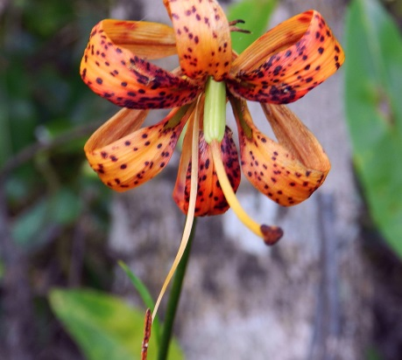
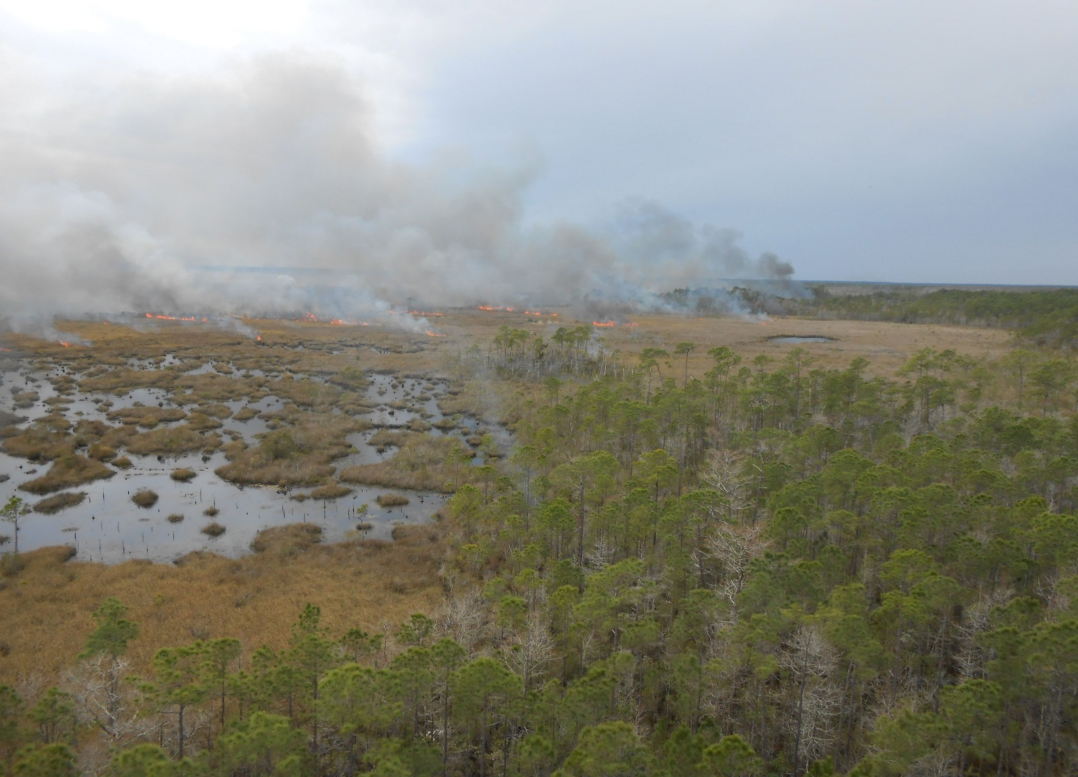
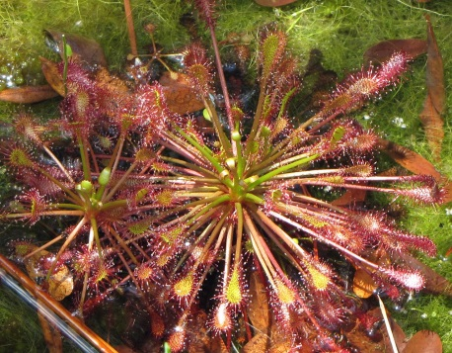
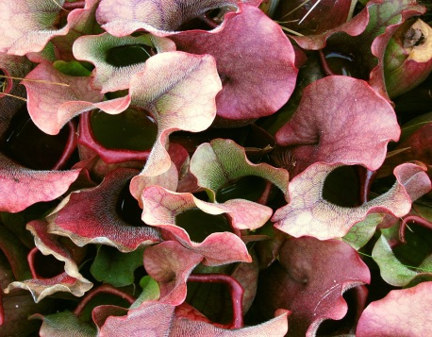
NORTHWEST FLORIDA WATER MANAGEMENT DISTRICT
Implementation
Notes:
Plants – top to bottom
1. Lilium iridollae – Panhandle Lilly – state endangered (Dutex mitigation site – on the bay)
2. Drosera intermedia
3. Purple Pitcher Plant – Sarracenia (District lands along the river)

Slide 20
NORTHWEST FLORIDA WATER MANAGEMENT DISTRICT
An Array of Funding Resources
RESTORE Bucket 1 County MYIPs | NFWF Gulf Environmental Benefit Fund | Florida Legislature
RESTORE Bucket 2 Gulf Coast Ecosystem Restoration Council | Florida Springs Restoration Funding | US EPA Section 319 Grants
RESTORE Bucket 3 Florida Gulf Consortium | NRDA Natural Resource Damage Assessment | Triumph Gulf Coast Inc.
RESTORE Bucket 4 NOAA Science Program | Florida Land Acquisition Trust Fund | TMDL Water Quality Restoration Grants
RESTORE Bucket 5 FL Inst. of Oceanography | Clean Water State Revolving Fund | FL Coastal Mgt Program
Notes:
Many related programs – all with different guidelines concerning what is eligible for funding
The main point here is that the focus and legislative intent for SWIM is limited to plans and programs for the improvement and management of surface waters.
Therefore not everything that is eligible for funding through some of these programs will be included within SWIM plans.
Some have goals for economic development, tourism, Gulf of Mexico fisheries, and working waterfronts that are not necessarily appropriate for SWIM.
Therefore what is or is not included within SWIM plans do not necessarily affect eligibility for other funding sources.

Slide 21
NORTHWEST FLORIDA WATER MANAGEMENT DISTRICT
Projects and Management Practices
Project/Practice | Objectives | Lead Entities
Urban Stormwater Retrofits | Water quality improvement Flood protection Example focus areas: Tenmile Creek Regional Pond Eightmile Creek Regional Pond Elevenmile Creek Regional Pond Lake Charlene/Bridle Trail Stormwater | Escambia County
Monitoring Program Development and Enhancement | Develop targeted monitoring program Identify trends Support adaptive management Building on efforts of Bream Fishermen’s Association, FDOH, FDEP, and others | Estuary Program Regional watershed initiatives
Basinwide Sedimentation Abatement | Watershed assessment of impacts from unpaved roads and other erosion sites Prioritize sites Support implementation Unpaved road/stream crossing sites Borrow pits | Local governments Estuary Program
Notes:
Estuary Program may be applicable to all…

Slide 22
NORTHWEST FLORIDA WATER MANAGEMENT DISTRICT
Projects and Management Practices
Project/Practice | Objectives | Lead Entities
Agricultural Best Management Practices (BMPs) | Water quality protection Water use efficiency Building upon initiatives developing in other regions of the state Includes Pensacola and Perdido Rivers & Bays Agricultural Water Quality and Conservation Cost Share Initiative – Florida Department of Agricultural and Consumer Services | FDACS NRCS Private producers NWFWMD
Silviculture BMPs | Water quality protection Habitat protection Building on Florida's Silviculture BMP program (FDACS); cooperative effort between public agencies and private landowners | FDACS Private landowners Public landowners
Interstate Coordination | Coordination of watershed management efforts across state lines Coordinate priority efforts | Estuary program

Slide 23
NORTHWEST FLORIDA WATER MANAGEMENT DISTRICT
Projects and Management Practices
Project/Practice | Objectives | Lead Entities
Wetland and Hydrologic Restoration | Restoration of natural wetland, floodplain, and estuarine hydrology Restore wetland functions, including habitat, floodwater storage; discharge regulation; water quality protection; aquifer recharge Stream channel restoration Enhance resiliency through biodiversity and natural adaptation enhancement Example focus areas and projects: Elevenmile Creek Eightmile Creek Bayou Marcus Bridge Creek Bayou Garcon Tarkiln Bayou Preserve – Restoration of Big Muddy | State and federal resource agencies Local governments Estuary Program

Slide 24
NORTHWEST FLORIDA WATER MANAGEMENT DISTRICT
Projects and Management Practices
Project/Practice | Objectives | Lead Entities
Subbasin Restoration Plans | Comprehensive restoration plans for targeted basins Stormwater treatment; flood protection; restoration of floodplains, wetlands, and riparian buffers Elevenmile Creek Big Lagoon Eightmile Creek Bayou Marcus Bridge Creek Bayou Garcon | Local governments Estuary Program
Landscape Scale Headwaters and Longleaf Pine Ecosystem Protection and Restoration | Achieve perpetual working forest conservation easements Restore historic longleaf pine ecosystem on approximately 205,000 acres (100,000 in Florida) Coastal Headwaters Longleaf Forest Related GCPEP proposal through Community-Based Watershed Plan | The Conservation Fund Gulf Coastal Plain Ecosystem Partnership FDACS Private landowners

Slide 25
NORTHWEST FLORIDA WATER MANAGEMENT DISTRICT
Projects and Management Practices
Project/Practice | Objectives | Lead Entities
Wastewater System Upgrades | Improvement of wastewater treatment and management Connect areas currently served by OSTDS to central sewer systems with effective water quality treatment Improved water quality through reuse of reclaimed water Innerarity Island Utility System standards upgrade Inflow and infiltration abatement Reuse of reclaimed water Septic to sewer connections | Utilities Local governments
Advanced Technology OSTDS | Implement affordable, new technology passive OSTDS in areas where connection to central sewer is not cost-effective | Utilities Local governments

Slide 26
NORTHWEST FLORIDA WATER MANAGEMENT DISTRICT
Projects and Management Practices
Project/Practice | Objectives | Lead Entities
Riparian Buffer Zones | Water quality protection Shoreline Stability Habitat Enhance resiliency through biodiversity and natural adaptation enhancement Protection of currently natural/undeveloped shoreline areas Perdido Key Access Improvements and associated habitat protection | Private landowners Local governments Estuary Program Escambia County
Living Shorelines | Shoreline habitat restoration Implementation of alternative method of shoreline protection that enriches littoral and aquatic habitat and productivity Enhance resiliency through biodiversity and natural adaptation enhancement Sunset Island Restoration Navy Shoreline at Bronson Field | Estuary Program State and federal resource agencies Local governments

Slide 27
NORTHWEST FLORIDA WATER MANAGEMENT DISTRICT
Projects and Management Practices
Project | Objectives | Lead Entities
Perdido River Water Quality Protection, Habitat Restoration and Recreational Enhancement | Expand conservation lands along the Perdido River Restore key habitats Enhance public access Protect wetland floodplains Hydrologic restoration through road fill removal and bridging Remove road fill; restore Black Lake Channel | TNC Escambia County
Seagrass Restoration | Targeted restoration in areas where water quality and other supporting site conditions have been achieved Sunset Island restoration | Estuary Program Florida FWRI Local governments
In-Estuarine Restoration | Benthic habitat restoration Oyster reef establishment Evaluation of alternative systems: aeration systems, pumped flushing systems, oyster habitat for water quality improvement | Estuary Program Escambia County Florida FWRI
Notes:
Any one project could support a presentation by itself.

Slide 28
NORTHWEST FLORIDA WATER MANAGEMENT DISTRICT
Projects and Management Practices
Project | Objectives | Lead Entities
Watershed Stewardship Initiative | Build citizen engagement opportunity and capacity, including: Citizen science Monitoring Training and outreach Habitat enhancement; oyster gardening Cost-share assistance to landowners to convert hardened to living shorelines | Estuary Program IFAS Extension/Sea Grant Proposed through Community-Based Watershed Plans
Evaluation and Planning for Strategic Land Acquisition and Conservation | Water resource protection for water quality, floodplain, and aquatic and wetland habitat protection Multiple specific projects proposed through Community-based Watershed Plans | Local governments Private non-profit initiatives Estuary Program FDEP
Notes:
Any one project could support a presentation by itself.

Slide 29
NORTHWEST FLORIDA WATER MANAGEMENT DISTRICT
Criteria for Project Planning and Evaluation
Infrastructure projects (stormwater and wastewater)
  Projects should have responsible parties that will implement, own, operate, and maintain the facilities
  Responsible parties should have dedicated funding source for operation and maintenance
Restoration and habitat enhancement
  Completed project should be naturally self-sustaining; not requiring frequent human intervention
  Restoration should reflect ecosystems or habitats that are naturally supported in the watershed and physical environment
  Completed restoration sites should be adaptable to natural change and variability – short-term and long-term
Milestones |  |  | Task Orders
1 | Quarterly Reports |  | 1 | Watershed Characterizations | 5 | Plan Development
2 | Public Hearing(s) |  | 2 | TAC Assistance | 6 | FY 17 TAC Assistance
3 | Final Reports |  | 3 | Final Characterizations | 7 | Public Engagement Assistance
 |  |  | 4 | Project Planning Assistance

Slide 30
NORTHWEST FLORIDA WATER MANAGEMENT DISTRICT
SWIM Plan Updates – Schedule
2015 |  |  |  |  | 2016 |  |  |  |  |  |  |  |  |  |  |  | 2017
AUG | SEP | OCT | NOV | DEC | JAN | FEB | MAR | APR | MAY | JUN | JUL | AUG | SEP | OCT | NOV | DEC | JAN | FEB | MAR | APR | MAY | JUN | JUL | AUG | SEP | OCT | NOV | DEC
Designated Grant Period
Watershed Characterizations
Project Planning
Draft Plans
Final Plans
Tech. Mtgs
Public Stakeholder Review

Slide 31
NORTHWEST FLORIDA WATER MANAGEMENT DISTRICT
Thank you!
Perdido River and Bay Watershed Resource Characterization:
http://www.nwfwater.com/Water-Resources/SWIM/SWIM-Plan-Updates
Please provide comments, recommendations, and questions to: SWIM@nwfwater.com
Comments requested by March 10, 2017
For more information:
Paul Thorpe
Chief, Bureau of Environmental and Resource Planning
Northwest Florida Water Management District
(850) 539-5999
Paul.Thorpe@nwfwater.com
Notes:
This is where we are at now.
Management options and projects need to be:
Applicable over the long-term (thus, not only including discrete projects that have come in the door to date)
Useful for local governments and others going forward
Umbrella projects identify broad priorities – site specific project options may be identified in the years ahead and may be applicable to multiple funding sources (Florida Forever, RESTORE, etc.).
Criteria to guide evaluation and prioritization examples:
Go through examples

